Slide 1
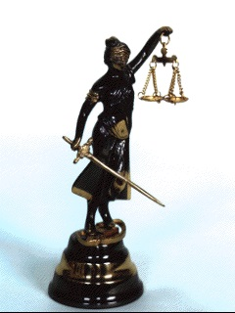
Moral code and Law
Emeritus professor of Nagoya University
KAGAYAMA Shigeru

Slide 2
Table of Contents
Class schedule, Self-introduction,
Aim of the Lecture, Preface
(1) Purpose of Law, (2) Method of Law
(3) Result of Law – Relation of Law, Moral and Religion
1. Golden Rule
(1) Case study1, After the case1
(2) Moral code, (3) Law
(4) Applicable law to the case1
2. Silver Rule
(1) Case study2
(2) Moral code, (3) Law
(4) Applicable law to the case2
3. Bronze Rule
(1) Case study3
(2) Moral code, (3) Law
(4) Applicable law to the case3
4. Promise Rule
(1) Case study4
(2) Moral code, (3) Law
(4) Applicable law to the case4
Conclusion
Appendix
Reference

Slide 3
Class Schedule
 | Thur. 17 Dec. 2020 | Fri. 18 Dec. 2020
14:45 ~ 16:15 | Self-Introduction | 3. Bronze Rule (Case3)
 | Aim of the Lecture | 4. Promise Rule (Case4)
 | Preface
16:30 ~ 18:00 | 1. Golden Rule (Case1) | Presentation of Students1,2
 | 2. Silver Rule (Case2) | Presentation of Students3,4
 |  | Conclusion

Slide 4
Self-Introduction (1/2)
I am a emeritus professor of Nagoya University and Meijgakuin University.
16 years ago, I was a professor of Nagoya University.
During 1997-2004 I was going to Asian countries, State of Mongolia, Vietnam, Cambodia, Laos, Uzbekistan and China to cooperate development of civil law.
Fortunately, these activities were evaluated from this university, I became to an emeritus professor of Nagoya University in 2008.
My specialty is civil law, but I also study consumer law, legal informatics (AI & Law), law & management, and copyright law.
I am currently writing a book titled "Introduction to Law for Children" on legal education for young children.

Slide 5
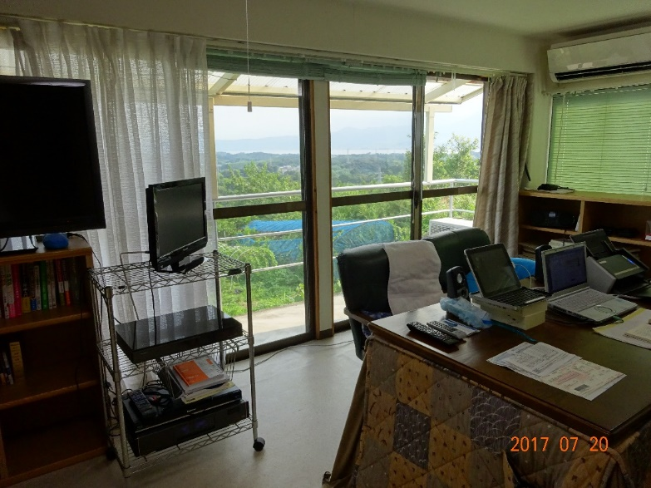
Self-Introduction (2/2)
Since retiring in 2017, I have moved to Oita Prefecture where my parents live.
I have been conducting research on copyright law at the Graduate School of Intellectual Property Studies (correspondence course) of Kibi International University, Junsei Gakuen.
In addition, I am an intensive lecturer of civil law for international students at Nagoya University Graduate School, and "Contract Law" at the Faculty of Law, Meiji Gakuin University.

Slide 6
The Aim of the Lecture
1. Trust in the human brain
2. Question about the human brain
3. Method for properly controlling mirror neuron
4. Confirmation of the problem-solving function of the law by case study
5. Cause of the lack of confidence in the law's problem-solving capabilities
6. Necessity of supplementing the function of explaining law by virtue of morality
7. Proper control of mirror neurons and the realization of peace through law and morality

Slide 7
The Aim of the Lecture
In this lecture, I hope to restore the public's confidence in the excellent problem-solving and peace-contributing functions of the law by utilizing the excellent explanatory functions of morality.

Slide 8
1. Trust in the human brain
The starting point for this lecture is trust in the human brain.
In particular, mirror neurons (sympathetic neurons) that enable people to empathize with one another, cooperate with one another, and share the results, as in "return a smile to someone's smile".

Slide 9
2. Question about the human brain
Mirror neurons, however, also react immediately to the other person's anger, causing "retaliate if one is beaten".
The endless chain of revenge and miserable wars are also the work of human mirror neurons.

Slide 10
3. Method for properly controlling mirror neuron
Therefore, if we are to prevent the chain of revenge or the horrors of war, we must not blindly follow the function of mirror neurons, but must respect the function of empathy and learn how to control the function of revenge of mirror neurons.
The best way is, I believe, morality and law.

Slide 11
4. Confirmation of the problem-solving function of the law by case study
In this lecture, we will try to clarify the superior problem-solving function of law and its contribution to peace by taking 4 cases , i.e.
(Case1) two women's life-saving activities on the sumo stage（Golden rule）,
(Case2) a traffic accidents and death caused by a self-driving car（Silver rule）,
(Case3) a payment of the other’s debt by mistake（Bronze rule） and
(Case4) nonpayment of leave of absence allowance by employers in response to requests for voluntary restraint in the spread of new coronavirus infection （Promise rule）
that reflect 3 moral codes and the latest events from the traditional ones.

Slide 12
5. Cause of the lack of confidence in the law's problem-solving capabilities
I would like to discuss why such a well-functioning law has not yet to gain the full trust of the public.
In this lecture, we hypothesize that the law was so focused on the combination of requirements and effects that it failed to clarify the moral reasons why the combination of requirements and effects was reasonable or ideal.

Slide 13
6. Necessity of supplementing the function of explaining law by virtue of morality
In order to test this hypothesis, I would like to make it clear that the existing conflict between law and morality can be restored by supplementing the explanation of the moral reasons behind the law, which consists of a combination of requirements and effects.

Slide 14
7. Proper control of mirror neurons and the realization of peace through law and morality
In this lecture, based on the above considerations, we will consider how to properly control mirror neurons in our brain by complementing the excellent conflict resolution of law with the moral explanation function.
In other words, we will further evolve the functions of the mirror neurons, which are called "return a smile to" or "empathy function", while we will consider how to properly control the "retaliate if one is beaten" or "retaliatory function" of the mirror neurons.
Through this, we will seek ways to realize world peace.

Slide 15
Preface
Purpose, Method and Result of Law
Relationship among Law, Morality and Religion

Slide 16
Type and source of Laws
Law
Written Law
Cabinet Order
Prefectural Ordinance
Ordinance of Ministry
Act or Code
Unwritten Law
Custom
Case Law
Legal Principle
Constitution
Treaty
Moral Code
Religious Code

Slide 17
The Purpose, Method and Result of Law In order to achieve the peace
Purpose of Law
is to resolve disputes peacefully before they happen or after they happen.
Method of Law
must follow peaceful and proper procedures (ex. Toulmin’s art of argument), and the result must be justice.
Result of the application of Law
must be peaceful solution, acceptable to both of parties, experts and then public opinion(including the view point of Moral and Religion).

Slide 18
(1) The purpose of Law
"The goal of the law is peace, and the means to reach it is struggle."
Rudolf v. Jaring, “Der Kampf ums Recht (The struggle for Right)”, 1872

Slide 19
The goal of the law is peace, and the means to reach it is struggle. Rudolf v. Jaring, “Der Kampf ums Recht (The struggle for Right)”, 1872
“All the laws of the world were fought against, and all the important laws had to first be taken from the hands of those who denied them. Law is not a mere thought but a living force.
Therefore, the goddess of justice has a measure of right in one hand and a sword in the other hand to claim it. A sword without measure is naked violence, and a measure without sword means the powerlessness of the law.
The measure and the sword are interdependent, and the perfect state of law exists only where the power of the sword of the goddess of justice and the skill of handling the measure are balanced.”

Slide 20
Both Goal and means of Law are peace
I think, however, there is no guarantee that real peace will be brought about by “struggle” by force.
This is because there is a high risk that a solution by force will lead to repeated struggles because it will not win the consent of the parties.
If that is the case, I believe that the means of law should be peaceful argument, as in “The goal of the law is peace”, and the means of reaching it is not struggle, but peaceful argument.

Slide 21
(2) The method of Law
Legal way of Thinking
Toulmin’s Diagram

Slide 22
IRAC as the legal way of thinking
Analyze, argue and draw your Conclusion
Analysis | Issue |  | Finding data & facts
 | Rules |  | Finding Rules
 | A | Application | Application of Rules, Tentative conclusions
 |  | Argument | Argument against / for tentative conclusions
Argument
 | Conclusion |  | Finding final conclusion

Slide 23
Top-down and Bottom-up way of thinking

Slide 24
The Myth of Judgment
Syllogism
Judgement
Major premise:
All men are motal.
Miner premise:
Socrates is a man.
Conclusion:
Socrates is mortal.
Substantive Law
If tortfeasor caused damage against a victim and there is fault in his act, then he should compensate the victim.
Fact finding
The victim proved the fault of tortfeasor.
Application of law to the fact
The tortfeasor should compensate the victim.

Slide 25
From Syllogistic to Toulmin Diagram
Syllogism (Admit of no exceptions)
Major premise: All men are motal.
Miner premise: Socrates is a man.
Conclusion: Socrates is mortal.
Toulmin Diagram (Admit of exceptions)
Probably no
Socrates is a man.
Probably yes
Socrates is mortal.
Data
Qualifier
Qualifier
Claim
Warrant
Rebuttal
Socrates is a man of god of philosophy.
All men are mortal.
All living things are mortal.
Backing
However, god and truth are immortal.

Slide 26
Application of Toulmin Diagram to Joke
The person who made a manifestation knows that it does not reflect his/her true intention.
The manifestation is valid.
Probably no
Probably yes
Data
Qualifier
Qualifier
Claim
Warrant
Rebuttal
When the other party knew or could have known the true intention, the manifestation is invalid.
The person who made a manifestation is liable to it.
Backing
The manifestation of intention which is concealed the true intention:
It is invalid in case the other party knew or could have known.
It is valid in case the other party is didn’t know and without negligence.

Slide 27
(3) The Result of Law
The result of law must be acceptable to both of parties, experts and then public opinion (including the view point of Moral and Religion).

Slide 28
Basis for Moral, Religion and Law
Basis for Trust
Morality
Teachings of respectable people
Religion
Teachings of God, beyond human beings
Law
Rules determined by people with due process

Slide 29
Conflict between people who believe in morality or religion and those who believe in law(1/2)
Moral norms are cultures that trust long-established practices and the teachings of the people they respect.
Religious norms are cultures that rely on the teachings of the omnipotent God, who transcends human beings.
On the other hand, Legal norms are culture that trusts rules determined by human groups with due process.

Slide 30
Conflict between people who believe in morality or religion and those who believe in law(2/2)
However, the legal group also includes people they do not respect (the merchant of death, corrupt politicians, foolish people deceived by money), often resulting in rules that are immoral.
Thus, people who place importance on morality or religion and trust in the teachings of the people they respect or Good suspect people who follow legal norms as impure people who trust rules made with money.

Slide 31
Need for reconciliation with people with differing grounds of trust(1/2)
In order for human beings to be social animals and to live a peaceful and comfortable life in society, rules are necessary, and a mutual relationship of trust is necessary for the groups that form the premise of the rules.
It is even more important for people to understand each other's reasons of trust in a society in which diverse cultures compete with each other due to the spread of human life.

Slide 32
Need for reconciliation with people with differing grounds of trust(2/2)
If you have a person whom you respect in common, you should respect their judgment;
If you believe in a common God, you should follow the teachings of God;
If you do not have such a common basis of trust, you should respect legal codes such as universal laws covering the widest area, treaties concluded between nations, national laws, and local ordinances.

Slide 33
Three Moral Codes
Moral Codes
Golden Rule
Do for others（Bible）
Management of business
Silver Rule
Bronze Rule
Don’t harm others（Analects of Confucius）
Tort Law
Don’t be enriched by others harm (Digesta)
Unjust enrichment

Slide 34
1. Golden Rule
Do to others as you would have them do to you.
(Luke 6:31 (Love for Enemies))

Slide 35
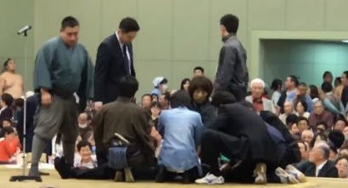
(1) Case study1 →Applicable law Maizuru City Grand Sumo Case (2018)
On April 4, 2018, at the “Spring Grand Sumo Tournament” held in Maizuru City, Kyoto Prefecture, when mayor Ryozo Tatami was giving a speech in the Sumo stage, he suddenly fell on his back (Later found to be critical due to a subarachnoid hemorrhage: serious disease caused by bleeding from blood vessels in the brain).
The hall was in an uproar, and while the people on the ring were panicking, two women in the audience stepped into the Sumo stage for life-saving treatment.
When the women were immediately started artificial respiration, the event in charge of the announcement repeatedly announced to them, "Women should get off the Sumo stage.".

Slide 36
After the Maizuru City Grand Sumo Case
After the Maizuru Sumo Case, the male rescue team arrived and took over the rescue work with the two women, and the mayor was rushed to the hospital and admitted to the hospital, where he survived.
The rescue operation of two women, ignoring the announcement "Women should get off the stage.", saved lives (The mayor of Maizuru is now recovering his health and returning to work.).
Subsequently, President Hakkaku of the Japan Sumo Association explained that the announcement of the event was "inappropriate as an emergency response".
On the other hand, there are opinions that the tradition of “Nyonin kinsei( 女人禁制：No women allowed in the Sumo stage)" should be respected and that announcements should be followed.

Slide 37
(2) Moral Code
Golden Rule
Matthew 7:12 (Ask, Seek, Knock, Do for others)
Luke 6:31 (Love for Enemies)

Slide 38
Golden Rule (1/4)
Matthew 7:12 (Ask, Seek, Knock, Do for others)
“Ask and it will be given to you; seek and you will find; knock and the door will be opened to you. ⁸ For everyone who asks receives; the one who seeks finds; and to the one who knocks, the door will be opened.
⁹ “Which of you, if your son asks for bread, will give him a stone? ¹⁰ Or if he asks for a fish, will give him a snake? ¹¹ If you, then, though you are evil, know how to give good gifts to your children, how much more will your Father in heaven give good gifts to those who ask him!
¹² So in everything, do to others what you would have them do to you, for this sums up the Law and the Prophets.

Slide 39
Reason of Golden Rule
Why you could receive if you ask someone to give?
Because a human has a heart to share and everyone feels happier to give something to someone than to receive something from someone.
There is more happiness in giving than in receiving
Acts of Apostles Chapter 20
³⁵ By every means I have shown you that we must exert ourselves in this way to support the weak, remembering the words of the Lord Jesus, who himself said, "There is more happiness in giving than in receiving."
Question
I wonder that the meaning of "Do for others" is equal to "Do whatever you want for others". If it is right, the meaning could become "small kindness is big trouble for others". Because it is not always equal between what you want to others and what others want to you.

Slide 40
Golden Rule (2/4)
Luke 6:31 (Love for Enemies)
²⁷ “But to you who are listening I say: Love your enemies, do good to those who hate you,
²⁸ bless those who curse you, pray for those who mistreat you.
²⁹ If someone slaps you on one cheek, turn to them the other also. If someone takes your coat, do not withhold your shirt from them.
³⁰ Give to everyone who asks you, and if anyone takes what belongs to you, do not demand it back.
³¹ Do to others as you would have them do to you.

Slide 41
An interpretation of Golden Rule
It is difficult to understand of context of 30-31 chapter 6 of the Gospel of Luke.
³⁰ Give to everyone who asks you, and if anyone takes what belongs to you, do not demand it back.
³¹ Do to others as you would have them do to you.
However, the meaning in this case is easier to understand if we switch positions.
The meaning of "Do for others" in this case would be the same as “Do to others as they would have you to do them”.

Slide 42
(3) Law
Article 698(Urgent Management of Business)

Slide 43
Golden Rule (3/4) § 677 BGB
§677 BGB (Pflichten des Geshäftsführers)
Wer ein Geshäft für einen anderen besorgt, ohne von ihm beauftragt oder ihm gegenüber sonst dazu berechtig zu sein, hat das Geshäft so zu führen, wie das Interesse des Geshäftsherrn mit Rücksicht auf dessen wirklichen oder mutmaßlichen Willen es erfordert.
Article 677(Duties of the voluntary agent)
A person who conducts a transaction for another person without being instructed by him or otherwise entitled towards him must conduct the business in such a way as the interests of the principal require in view of the real or presumed will of the principal.

Slide 44
Golden Rule (4/4) Civil Code of Japan →Applicable Law
Chapter 3 Negotiorum Gestio (Management of Business))
Article 697 (Management of Business) (1) A person who commences the management of a business for another person without being obligated to do so ("Manager") must manage that business ("Management of Business") in accordance with the nature of the business, using the method that best conforms to the interests of that another person (“the principal”).
(2) The Manager must engage in Management of Business in accordance with the intentions of the principal if the Manager knows, or is able to conjecture that intention.

Slide 45
The reason for Art. 697, Civil Code of Japan
The spirit of the legislation of paragraph 2 of Civil Code 697 is as follows:
If a manager is aware of or possible to perceive the principal's intention regarding management, the manager has to do business management in accordance with the principal's intention. In this case, the manager should not manage with the method prescribed in paragraph 1.
Under the name of business management, a manager should not interfere in the affairs of others in vain. In addition, the manager should not be what others do not want.
Even if there is a benefit to a person, but if it is contrary to the person's will, the manager should not interfere with the affairs. Such a thing is, is contrary to the spirit of the legislation of business management.

Slide 46
(4) Applicable law to the case1
Article 697 (Management of Business)
Article 698(Urgent Management of Business)
Article 700(Continuation of Management of Business by Managers)

Slide 47
Applicable articles in Maizuru City Grand Sumo Case (2018)
Urgent Management of Business
Article 698 If a Manager[woman] engages in the Management of Business[artificial respiration] in order to allow a principal[Mayer] to escape imminent danger to the principal's person, reputation or property, the Manager[woman] shall not be liable to compensate for damages resulting from the same unless he/she has acted in bad faith or with gross negligence.
Continuation of Management of Business by Managers
Article 700 A Manager[woman] must continue the Management of Business[artificial respiration] until the principal[the mayer] or his/her heirs or legal representatives[male rescue team] can undertake it;
provided, however, that this shall not apply in cases where it is evident that the continuation of the Management of Business is contrary to the intentions of the principal, or is disadvantageous to the principal.

Slide 48
2. Silver Rule
Do not do unto others what you would not have done unto you.”
The Analects of Confucius 15-24.

Slide 49
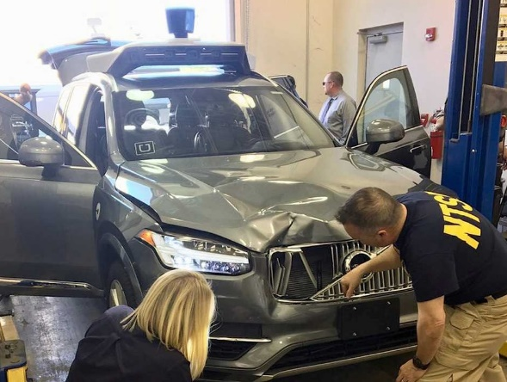
(1) Case study2: →Applicable law A self-driving car caused death of a pedestrian
UBER Technologies, Inc., a car-hailing company(Y) in the United States, carried out a test drive of a self-driving car made by Volvo (Z) in Tempe, Arizona, in March 2018, hit and killed a pedestrian X (Elaine Hertzberg (49)) crossing a road by pushing a bicycle.
A safety driver in the car was charged with involuntary manslaughter in connection with the accident. At the time of the accident, Rafael Vasquez, a safety driver in a self-driving car, was watching "The Voice" according to investigators.
In civil cases, what responsibility does the manufacturer, owner, and driver of the self-driving car assume for X's death?
https://www.businessinsider.jp/post-214243

Slide 50
(2) Moral Code
Zi Gong asked, “Is there any words that I have to obey my whole life?” Confucius replied, “It is thoughtfulness. Do not do unto others what you would not have done unto you.”
The Analects of Confucius 15-24.

Slide 51
(3) Law
French Civil Code (1804)
German Civil Code (1900)
Japanese Civil Code (1898)

Slide 52
French Civil Code(1804)
Art. 1382 (Civil responsibility in general)
Any act whatever of man, which causes damage to another, obliges the one by whose fault it occurred, to compensate it.
Tout fait quelconque de l'homme, qui cause a autrui un dommage, oblige celui par la faute duquel il est arrivé, a le réparer.
Characteristics
There is no term of right in this provision.
It means that all of rights and legal interests can be compensated.
Prerequisite is only 3: fault, damage, and causation between fault and damage.

Slide 53
German Civil Code(1900)
§ 823 (Duty to compensate for damage)
(1) A person who, wilfully or negligently, unlawfully injures the life, body, health, freedom, property or other right of another is bound to compensate him for any damage arising therefrom.
(1) Wer vorsaetzlich oder fahrlaessig das Leben, den Koerper, die Gesundheit, die Freiheit, das Eigentum oder ein sonstigers Recht eines anderen widerrechtlich verletzt, ist dem anderen zum Ersatz des daraus entstehenden Schadens verpflichtet.
Characteristics
Limited list of rights: Pure economic loss is excluded.

Slide 54
Japanese Civil Code (1896)
Article 709 (Tort in general - compensation for damage)
A person who has intentionally or negligently infringed any right of others, or legally protected interest of others, shall be liable to compensate any damages resulting in consequence.

Slide 55
Difference between Criminal law and Civil law
Criminal law （Legality principle）
Civil law (Remedy)
Type of Crime:
Assault
Type of torts: Assault
Not guilty
The other type
Punishment
The other type
Remedy
General principle
Type of Crime:
Battery
Type of torts: Battery
Typology
General principle

Slide 56
Function of special torts

Slide 57
Best 20 Articles of Civil Code of Japan from the view point of frequency of application(1945-2013)

Slide 58
Best 30 Articles of Civil Code of Japan
No. | Articles |  | No. | Articles |  | No. | Articles
1 | General tort law |  | 11 | Unjust Enrichment |  | 21 | Liability of land
2 | Compensation |  | 12 | Termination |  | 22 | Prescription of tort
3 | Comparative Negligence |  | 13 | Mistake |  | 23 | Duty of Care of Mandatary
4 | Employers’ liability |  | 14 | Lease |  | 24 | Sale
5 | Non Performance of contract |  | 15 | Apparent Agency |  | 25 | Loan for use
6 | General Principles |  | 16 | Next kin’s right for compensation |  | 26 | Division of Inherited Property
7 | Joint tortfeasor |  | 17 | Scope of Damages |  | 27 | Action Paulienne
8 | Pubic policy |  | 18 | Defamation |  | 28 | Acquisitive prescription
9 | Transfer real estate and registration |  | 19 | Quasi-Mandate |  | 29 | Free of contract
10 | Restriction of sublease |  | 20 | Judicial Divorce |  | 30 | Action oblique

Slide 59
Dynamic understanding of general tort law (1/4)
Intention or negligence
Causation
Damage
Incapability
Excuse
3 years from awareness of tortfeasor
Comparative negligence
Damages
Extinctive prescription
20 years from the accident

Slide 60
Dynamic understanding of general tort law (2/4)
Intention or negligence
Causation
Damage
Incapability
Excuse
Comparative negligence
Damages

Slide 61
Dynamic understanding of general tort law (3/4)
Intention or negligence
Causation
Damage
Incapacity
Excuse
Comparative negligence
3 years
Damages
Extinctive prescription
20 years

Slide 62
Dynamic understanding of general tort law (4/4) Product liability
Causality
Damage
Defect
Legal capacity
Even if the manufacturer's negligence cannot be proven, negligence can be presumed by proving a defect in the product.
Exemptions
Self-defense etc.
Comparative negligence
Damages

Slide 63
Illustration of Point of Due Care

Slide 64
Two types of payments cause completely different results
Payment of obligor
Payment of Gurantor
Obligor
Garantor
債務者
保証人
Obligor
Garantor
\10 Mil
1000万円
0円
\10 Mil
\10 Mil
\10 Mil
\10 Mil
0円
Total Payment
Obligee
Obligee
Total Payment
Both obligations are extinguished
The credit move from Obligee to Garantor. Obligation of Obligor not extinguished and exist for the purpose of reimbursement.

Slide 65
Structure of several and joint liability
Joint debtorY₁
Joint debtor Y₂
Joint debtor Y₃
300+(300)
200+(400)
100+(500)
Surety of Y₃ 100
600
Surety of Y₃ 100
Surety ofY₂ 200
600
600
Surety of Y₂ 200
Surety of Y₁ 300
Surety of Y₁ 300
Y₁’s obligation 300
Y₂’s obligation
200
Y3’s obligation 100
300
600
100
300
200
200
100
600
200
300
100
600
Obligee X

Slide 66
Subrogation of joint obligor by total payment
Joint obligor Y₁
Joint obligor Y₂
Joint obligor Y₃
Surety of Y₃ 100
Surety of Y₃ 100
Surety of Y₂ 200
Surety of Y₂ 200
Surety of Y₁ 300
100
Surety of Y₁ 300
200
100
200
Y₁’s obligation 300
Y₂’s obligation
200
Y₃’s obligation 100
300
200
100
100
300
200
200
300
100
Obligee X
600→0
Obligee X
600

Slide 67
(4) Applicable Law to the case2
Article 719(Joint and several liability of multiple tortfeasors), Civ. Code of Japan
Act on Securing Compensation for Automobile Accidents
Product Liability Act

Slide 68
Multiple Tortfeasors →Case2
Article 719(Joint and several liability of multiple tortfeasors)
(1) If two or more persons[Y,Z] have by their joint unlawful act caused damage to another[X], they are jointly and severally liable to make compensation for such damage; the same shall apply if it is impossible to ascertain which of the joint participants has caused the damage.
(2) Instigators and accomplices are deemed to be joint participants.

Slide 69
Act on Securing Compensation for Automobile Accidents →Case2
Article 3(Automobile Liability)
A person[Y] that puts an automobile into operational use for that person's own benefit is liable to compensate for damage arising from the operation of the automobile if this results in the death or bodily injury of another person[X];
provided, however,
that this does not apply if the person[Y] and the driver prove that they have exercised due care in connection with the operation of the automobile,
that the injured party[X] or a third party other than the driver has acted intentionally or negligently,
and that there was no defect in automotive structure or function.

Slide 70
Act on Securing Compensation for Automobile Accidents－Direct Action →Case2
Article 16(Filing a Claim with the Insurer for Damages)
(1) If a person[Y] in possession becomes liable to compensate for damage as under Article 3, the injured party[X] may file a claim with insurer for the insurer to pay the injured party damages of up to the amount of insurance coverage, pursuant to Cabinet Order.

Slide 71
Product Liability Act (1/2) →Case2
Article 3(Product Liability)
The manufacturer[Z], etc. shall be liable for damages arising from the infringement of life, body or property of others[X] which is caused by the defect in the delivered product which was manufactured, processed, imported, or provided with the representation of name, etc. described in item 2 or item 3 of paragraph 3 of the preceding Article, provided, however, that the manufacturer, etc. shall not be liable when the damages occur only with respect to such product.

Slide 72
Product Liability Act (2/2) →Case2
Article 4 (Exemptions)
In cases where Article 3 applies, the manufacturer[Z], etc. shall not be liable as provided in Article 3 if he/she proves that:
(i) the defect in such product could not have been discovered given the state of scientific or technical knowledge at the time when the manufacturer, etc. delivered the product; or
(ii) in case where the product is used as a component or raw material of another product, the defect occurred primarily because of the compliance with the instructions concerning the design given by the manufacturer of such another product, and that the manufacturer, etc. is not negligent with respect to the occurrence of such defect.

Slide 73
Dynamic understanding of general tort law (4/4) Product liability →Case2
Causality
Damage
Defect
Legal capacity
Even if the manufacturer's negligence cannot be proven, negligence can be presumed by proving a defect in the product.
Exemptions
Self-defense etc.
Comparative negligence
Damages

Slide 74
Division of responsibility of a defective car →Case2
Art. 3 PL law
Seller of
Defective car
②Non-perfor- mance
Producer of defective car
Owner of defective car
Art. 3 PL law
③Art. 3
PL law
①Art. 3 Compensation for traf. Acci.law
Victim of defective car

Slide 75
3. Bronze Rule
No one should be enriched by another loss or injury.
(D.50. 17. 206)

Slide 76
(1) Case study3: Payment by error →Applicable law
Case in which a person who is neither a obligor nor an guarantor paid another person’s debt by mistake
① A (third party) mistakenly believed that he was the obligor C himself or his guarantor and paid the debt to the obligee B (payment by mistake).
② B (creditor) considered that A’s payment was due performance of C’s debt and destroyed the debt instrument, or lost the opportunity to claim against the obligor after the period of prescription expired.

Slide 77
Case study: Payment by error →Applicable law
①A pay to B in error
③To prohibit to restitute against Obligee B
Third party A（Loss）
Obligee B
② B lost the opportunity to claim against Obligor C.
④To admit to restitute against Obligor C
Obligor C
（benefit）

Slide 78
Case study : Payment by error →Applicable law
In this case, A, who has made the payment by mistake, can claim to whom and what?
③ Can A claim restitute(to return back) of amount paid against oblige B on the basis of unjust enrichment?
④ Can A exercise the right to obtain reimbursement against obligor C based on substantial business management?

Slide 79
(2) Moral Code
Jure naturae aequum est neminem cum alterius detriment et injuria fieri locupletiorem. (D.50. 17. 206)
By natural law it is just that no one should be enriched by another loss or injury.

Slide 80
(3) Law
Art. 703(Obligation to Return Unjust Enrichment), Civ. Code of Japan
Art. 704(Obligation of Beneficiaries in Bad Faith to Return), Civ. Code of Japan
Art. 707(Performance of Obligations of Others), Civ. Code of Japan

Slide 81
Type of unjust enrichment
1. General unjust enrichment
Bona fide unjust enrichment
2. Special unjust enrichment
A. Benefiting unjust enrichment
C. Violating unjust enrichment
failing to become torts
Mala fide unjust enrichment
failing to become contract
B. Redeeming unjust enrichment
failing to become management of another’s affairs

Slide 82
Unjust enrichment (1/3) A. Benefiting unjust enrichment
Art. 703
(Obligation to Return Unjust Enrichment)
Art. 704
(Obligation of Beneficiaries in Bad Faith to Return)
A person who has benefited ("beneficiary") from the property or labor of others without legal cause and has thereby caused loss to others shall assume an obligation to return that benefit, to the extent the benefit exists.
A Beneficiary in bad faith must return the benefit received together with interest thereon.
In such cases, if any damages still remain, the Beneficiary shall be liable to compensate for the same.

Slide 83
Unjust enrichment (2/3) B. Redeeming unjust enrichment
Article 190(Return of Fruits by Possessors in bad faith)
Article 707(Performance of Obligations of Others by mistake)
(1) A possessor in bad faith shall be obligated to return fruits, and reimburse the price of fruits that he/she has already consumed, has damaged due to negligence or has failed to collect.
(2) The provisions of the preceding paragraph shall apply mutatis mutandis to persons who possess Thing through violence or duress, or by concealing the same.
(1) In cases where a person who is not an obligor has performed an obligation by mistake, if the obligee has, in good faith, allowed the instrument to be lost, damaged the instrument, waived the security or lost the claim by prescription, the person who performed the obligation may not demand the return of the performance.
(2) The provisions of the preceding paragraph shall not preclude the person who performed an obligation from exercising his/her right of subrogation against the obligor.

Slide 84
Unjust enrichment (3/3) C. Violating unjust enrichment
Article 191
(Compensation for Damages by Possessors)
Article 248(Compensation in conjunction with Accession, Mixture or Processing)
If possessed Thing has suffered loss or damage due to reasons attributable to the possessor, a possessor in bad faith shall be liable to compensate the person recovering the loss for the entire loss, and a possessor in good faith shall be liable to compensate such person for the loss to the extent he/she is actually enriched as a result of such loss or damage; provided, however, that a possessor who does not have the intention of holding as owner must compensate the entire loss, even if he/she is in good faith.
A person who suffers loss because of the application of the provisions of Article 242 through the preceding Article (conjunction with Accession, Mixture or Processing) may demand compensation in accordance with the provisions of Article 703 and Article 704.

Slide 85
(4) Applicable Law to the case3
Art. 707(Performance of Obligations of Others), Civ. Code of Japan

Slide 86
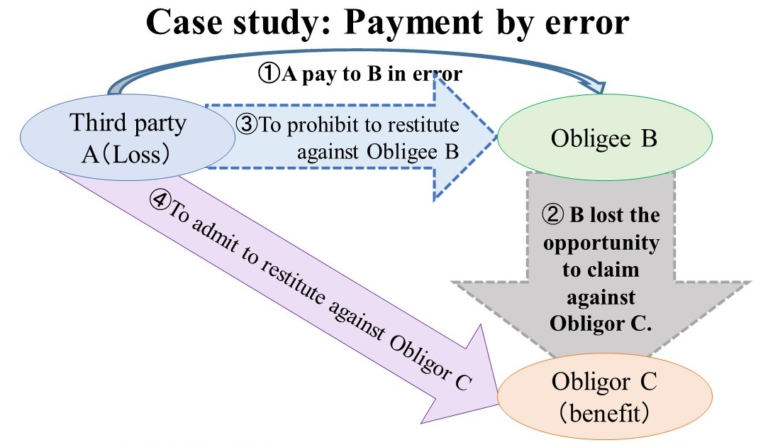
Unjust enrichment (2/2) Applicable law to the case3
Article 707(Performance of Obligations of Others)
(1) ①In cases where a person[A] who is not an obligor has performed an obligation by mistake, ②if the obligee[B] has, in good faith, allowed the instrument to be lost, damaged the instrument, waived the security or lost the claim by prescription, ③the person who[A] performed the obligation may not demand the return of the performance.
(2) ④The provisions of the preceding paragraph shall not preclude the person[A] who performed an obligation from exercising his/her right of subrogation against the obligor[C].

Slide 87
4. Promise Rule
Pacta sunt servanda.
Agreements must be kept.

Slide 88
Case study4: Absence from work allowance due to Corona disaster Case(1/2) →Applicable law
By the extension of the new coronavirus infection, the Japanese government requested the self-restraint of the business of various business types. Self-restraint is a non-binding request.
Employer Y accepted the government's request and closed his business. During this period, no allowance was paid to workers X.
Workers X et al. claimed that the reason why X et al. could not work was the absence from work due to the personal reasons of Employer Y, and requested that Employer Y pay the absence from work allowance in accordance with Article 26 (leave allowance) of the Labor Standards Act.

Slide 89
Case study4: Absence from work allowance due to Corona disaster Case(2/2) →Applicable law
Employer Y, on the other hand, argues that the absence from work is based on the request of the government and is not due to reasons attributable to the employer, and that the absence from work allowance cannot be paid.
Labor Standards Act Article 26(Allowance for Absence from work)
In the event of an absence from work for reasons attributable to the Employer, the Employer shall pay an allowance equal to at least 60 percent of the Worker's average Wage to each Worker concerned during said period of absence from work.
Is it allowed to pay leave allowance? What is the reason?

Slide 90
(2) Moral Code
Pacta sunt servanda
Agreements must be kept.

Slide 91
(3) Law
Understanding Contract
Flow of a contract, Type of contracts, Type of obligations
Formation of contract, Validity of contract
Remedies of non-performance of contract

Slide 92
Flow of Contract
Start
Formation
No（not concluded）
Unjust enrichment
Yes
Validity
No（invalid/avoidable）
（Continued）
Yes
Effective
No
No
Condition
Damages
No（non performance）
No
Performance
Excuse
Termination
Yes
Specific performance
End

Slide 93
Type of contracts
Contracts
Transfer Ownership
No transfer ownership
Use and return
gratis
onerous
1. Gift
2. Sale
3. Exchange
No need to return
Need to return
4. Loan for Consumption
gratis
5. Loan for use
onerous
6. Lease
Supply Service
7. Employment
8. Work
9. Mandate
10. Bailment
Resolution of dispute
13. Compromise
Enterprise
11. Association
12. Life Annuity
Time limited work
Independent work
Paying Money
Exchange goods
Completion of work
Office work
Deposition of things
Organization
Annuity

Slide 94
Type of Obligations
Viewpoint | Type of obligations |  | comment
Origin | Express obligation |  | From stipulation of parties
 | Implied obligation |  | From purpose and Nature of contract, practices and usages, good faith and fair trading, reasonableness
Execution | Obligation to give | Pay money | Easiest to execute
 |  | Deliver things | Easy to execute
 | Obligation to do or not to do |  | Difficult to execute: change to the damages in case of non-performance
Evidence | Obligation to achieve a specific result |  | Obligee should prove non-fault
 | Obligation of best efforts |  | Obligore should prove obligor’s fault

Slide 95
The effect of sale contract (Art. 176 Code Civil of Japan)
Property right
1st Buyer
Sale contract
Seller
Article 176(Creation and Transfer of Real Rights)
The creation and transfer of real rights shall take effect
solely by the manifestations of intention of the relevant parties.

Slide 96
The effect of the double selling of a real estate(Art. 177 Code Civil of Japan)
Property right
1st Buyer
1st Sale contract
Seller
Registration
2nd Sale contract
Denial of the transfer of real right
2nd Buyer

Slide 97
Condition of the validity of Contract
(b) The representation of will is consistent with its internal will
(c) Without unfair intervention to their decision making process
(d) The contents conform to the public order
(e) Following Good faith and fair trading
Condition of the validity of contract
(a) The legal capacity or with sufficient authority

Slide 98
Remedies of Non-performance of Contract
(b) Termination
(c) Damages
Remedies of non-performance of contract
(a) Specific Performance

Slide 99
(4) Applicable law to the Case4
Labor Standards Act
Article 26(Allowance for Absence from work)
Civil Code
Article 536(Obligors' Assumption of Risk)

Slide 100
Labor Standards Act →Case4
Article 26(Allowance for Absence from work)
In the event of an absence from work for reasons attributable to the Employer, the Employer shall pay an allowance equal to at least 60 percent of the Worker's average Wage to each Worker concerned during said period of absence from work.

Slide 101
Civil Code →Case4
Article 536(Obligors' Assumption of Risk)
(1) Except in the cases provided for in the preceding two Articles, if the performance of any obligation has become impossible due to reasons not attributable to either party, the obligor shall not have the right to receive performance in return.
(2) If the performance of any obligation has become impossible due to reasons attributable to the oblige[the employer], the obligor[the employee] shall not lose his/her right to receive performance in return. In such cases, if the obligor gains any benefit as a result of being released from his/her own obligation, the obligor must reimburse the obligee for the benefit.

Slide 102
Payment or non-payment of absence allowance based on burden of risk →Case4
Employer who decided temporary absence from work (creditor of the burden of risk) | Applicable law | Allowance based on temporary absence from work
No ground for blame (Leave of absence is due to force majeure) | Article 536, Paragraph 1 of the Civil Code | Allowance is not paid
With ground for blame (Absence from work is determined by the employer) | Article 536, Paragraph 2 of the Civil Code | Allowance shall be paid

Slide 103
Civil Code - Article 415(Compensation for Loss or Damage Due to Non-Performance) →Case4
(1) If an obligor fails to perform consistent with the purpose of the obligation or the performance of an obligation is impossible, the obligee may claim compensation for loss or damage arising from the failure;
provided, however, that this does not apply if the failure to perform the obligation is due to grounds not attributable to the obligor in light of the contract or other sources of obligation and the common sense in the transaction.

Slide 104
Conclusion
For Achieving World Peace

Slide 105
Conclusion (1/6) Contract and non-contractual obligations
So far, the center of property law has been placed in contract law, and the business administration (Golden rule), tort (Silver Rule), and unjust enrichment (Bronze Rule), which were taken up at the beginning of this lecture’s issues, have been placed after contracts in the our legal code as non-contractual obligations.
And, in the ordinary lectures, it was not rare that business management, tort, unjust enrichment were lectured after the contract.

Slide 106
Conclusion (2/6) Non-contractual obligations and morality
However, when we focus on moral code, it is gradually becoming clear
that non-contractual obligations (business management, tort, and unjust enrichment) dealing with the Golden Rule, the Silver Rule, and the Bronze Rule are rather important,
and that reasonable contracts with sufficient moral code (e.g. Non-mandatory rule of contract) should be kept,
on the contrary that unreasonable contracts which favor only one party and impose severe responsibility on the other party need not be kept.

Slide 107
Conclusion (3/6) New type of contract law
For example,
Article 10 of the Consumer Contract Act, which reflects the recent theory of contract, and
Article 548, paragraph 2 of the Civil Code, which was revised recently, provide that
"any clause which restricts the rights or aggravates the obligations of the other party and which is found to be unilaterally harmful to the interests of the other party, contrary to Article 1, paragraph 2 [the Rule of Faith], shall be deemed to be a failure to agree [null and void]".

Slide 108
Conclusion (4/6) Contractual justice
In other words, it has becoming clear that the business administration, tort and unjust enrichment, formed on the basis of the moral code, lie behind contracts, and that unreasonable contracts which ignore these norms are invalid and do not need to be kept.
This trend has attracted attention as a check on the excessive “freedom of contract” from the perspective of “contractual justice”.

Slide 109
Conclusion (5/6) Harmonization of Morality and Law
In that sense, the purpose of this lecture is also an attempt to reevaluate the moral code on which the legal norm is based, and to restore and reconstruct the relationship between law and morality.
This is because the purpose of law is the peaceful resolution of disputes, and in order for the settlement to be acceptable to both parties, to experts, and to the general public, it is ultimately necessary that the settlement also conforms to the moral code.

Slide 110
Conclusion (6/6) My hope
It is my sincere hope
that the world of morality and the world of law, which have been at odds with each other up until now, will come to a compromise,
and that various disputes will be resolved peacefully through repeated efforts to restore harmony between the moral code and the law.

Slide 111
Appendix
Tips of Teaching Law
Japanese Law Translation
http://www.japaneselawtranslation.go.jp/law/
Civil Code of Japan (Part 1-3), Revied version
Civil Code of Japan (Part 4-5)

Slide 112
Appendix Tips of Teaching Law (1/2)
Teaching Method
Work out your Teaching Plan.
Reduce that plan by half.
On half for lecture and another half for practice (ex. Students’ Presentation).
Teaching is Learning
You have to study before teaching.
Teaching is equal with learning and reporting before an audience.

Slide 113
Appendix Tips of Teaching Law (2/2)
Don’t teach too much.
Let students more practice than teach.
Then they will learn by themselves.
Teach basic idea through solving one of the most difficult problems.
When student can solve such a difficult matter, she/he mastered basic ideas naturally.
Try to become the most excellent teacher.
Imitate her/his（e.g. Prof. Kagayama’s） methods first.
Create new methods after your experiences.

Slide 114
Reference
"A way of thinking" of lawyer
Rudolf Von Jhering (translated by Kosuke Kobayashi and Hirosawa ) "Struggle for right " , (original 1872) Nippon Hyoronsha (1978).
Chaïm Perelman (translated by Eguchi Misumi) "Logic of lawyer - - new rhetoric-- ", Bokutaku-sha (1986).
KAGAYAMA Shigeru, “Modern Civil Code of Japan -- Introduction and learning method of Civil law of Japnan -- ”, Shinyama-sha ( 2007).
Approaching to human nature
NHK Special crew, " Human -- Why do Homo sapiens become to humans? -- “, Kadokawa Shoten (2012).
How to debate
Aristotle (translated by Totsuka Shichiro), "Public speaking" Iwanami (1992).
FUKUZAWA Kazuyoshi, "Lessons of discussion " NHK life who Shinsho (2002).
IWATA Muneyuki, "Rule book of discussion", Shincho Shinsho (2007) 206 pp.
Stephen Toulmin (translated by Todayama Kazuhisa , Kazuyoshi translation Fukuzaw ), “A technique pf discussion, (Stephen Toulmin, "The Uses of Argument", (1958, 2003)) " Tokyo Shoseki ( 2011).
Moral Code and Law December 17-18, 2020 Emeritus Professor of Nagoya Univ. KAGAYAMA Shigeru
Thank you for your attention.

